Slide 1
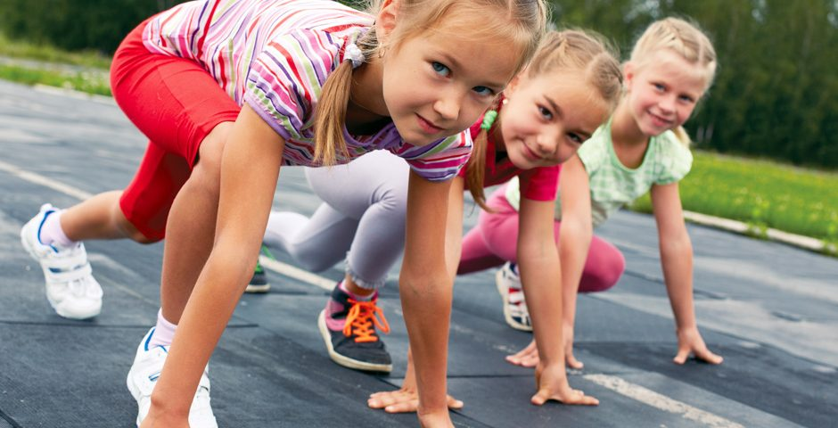

StartVaardig
Team Motoric
Lisa Dumaij
19049838
Yuliya Litvin
20161417
Mustafa Mousa
18068987
Pascal Seegers
21132844
Joost van Viegen
18048757
Joep van der Zanden
19134282
Motoric Skills Development

Slide 2
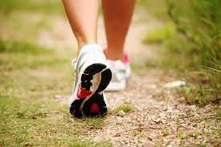
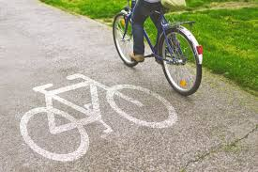
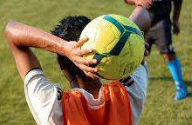
2
Gross Motoric Skills

Slide 3
3
Gross Motoric Skills

Slide 4
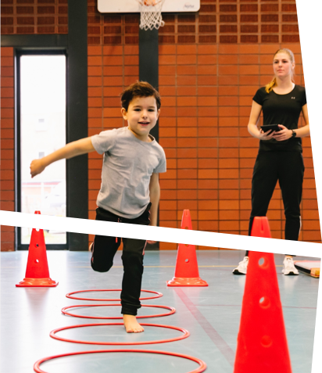

4
StartVaardig
Started in 2019
Providing tools
Value of motoric skills

Slide 5

a
5
Measurements & Tests
Competence
Motivation
Perception
Questionaires
BMI
Research question
„ How can data science be used to predict whether a child has a chance of developing a lack in motor skills a year later? “

Slide 6
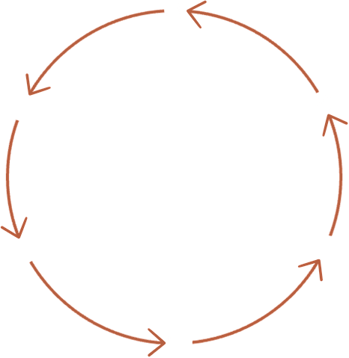
6
Data Preparation
Research Paper
Feature Selection
Evaluation
Splitting
Progress
Models

Slide 7
Data Preparation
&
Feature Selection

Slide 8
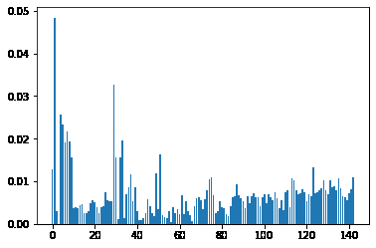
8
Data Preparation
Basics
Outliers
Imputation
Splitting
Feature Selection
RandomForest
Heatmap

Slide 9
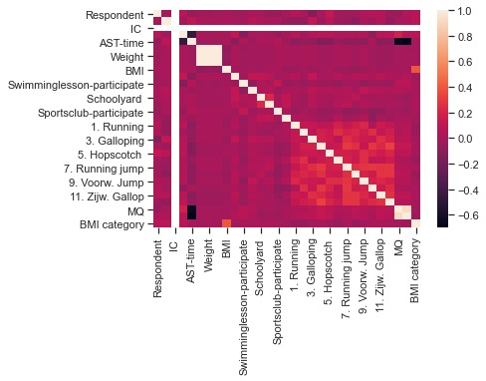
9
Correlation

Slide 10
10
Models
KNN
RandomForest
Decision Tree
Gradient Boosting Classifier
Bagging Classifier
Evaluation
Confusion Matrix
False Negative Rate
Precision-recall Curve
Notes:
Hyperparameter tuning

Slide 11
11
MODEL | FN RATE
Random forest | 0.21
KNN | 0.18
Decision Tree | 0.19
Gradient Selecting Classifier | 0.24
Bagging Classifier | 0.24
False Negative Rate

Slide 12
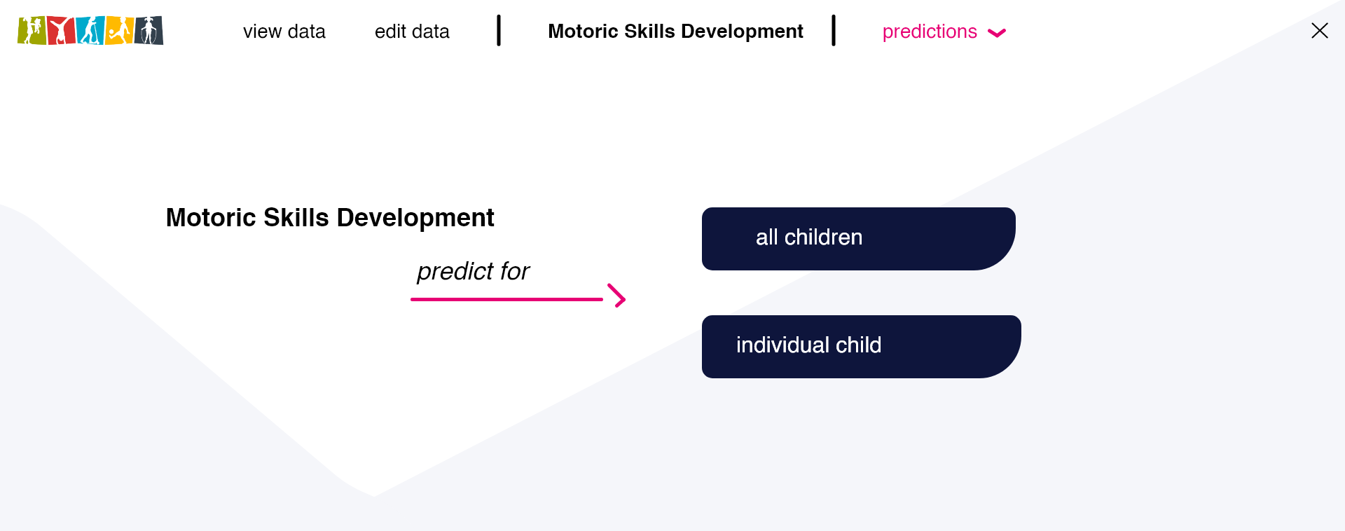
12
User Interface Prototype

Slide 13
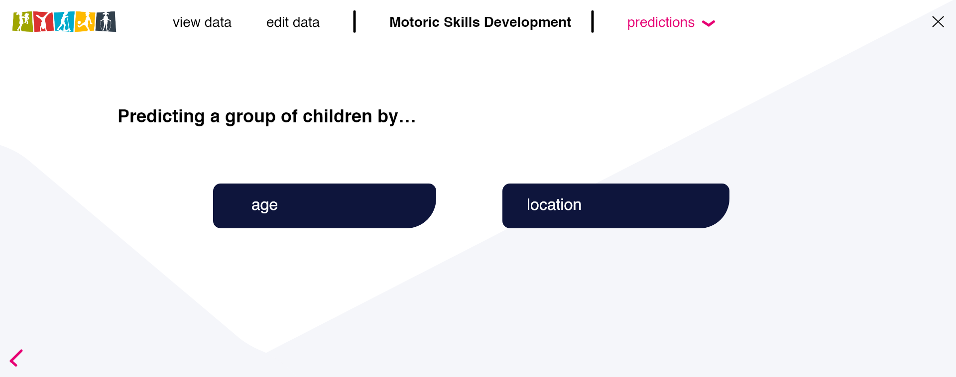
13
User Interface Prototype

Slide 14

14
User Interface Prototype

Slide 15
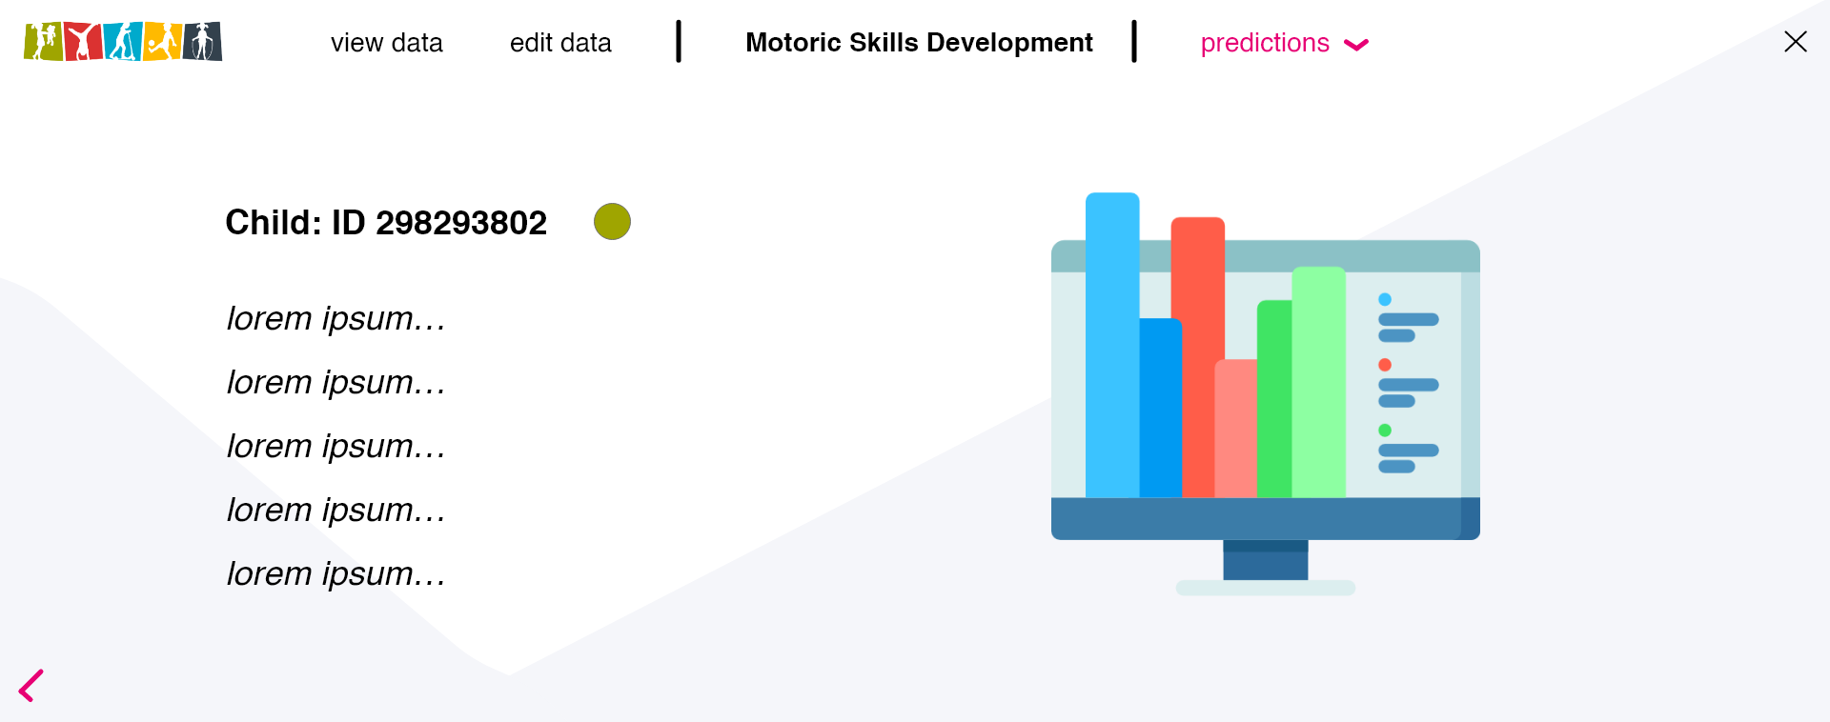
15
User Interface Prototype

Slide 16

16
User Interface Prototype

Slide 17

17
User Interface Prototype

Slide 18
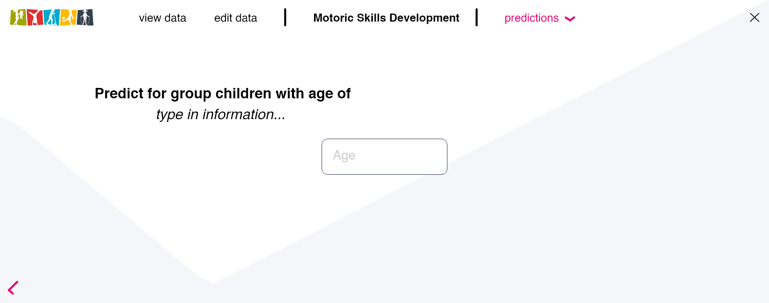
18
User Interface Prototype

Slide 19
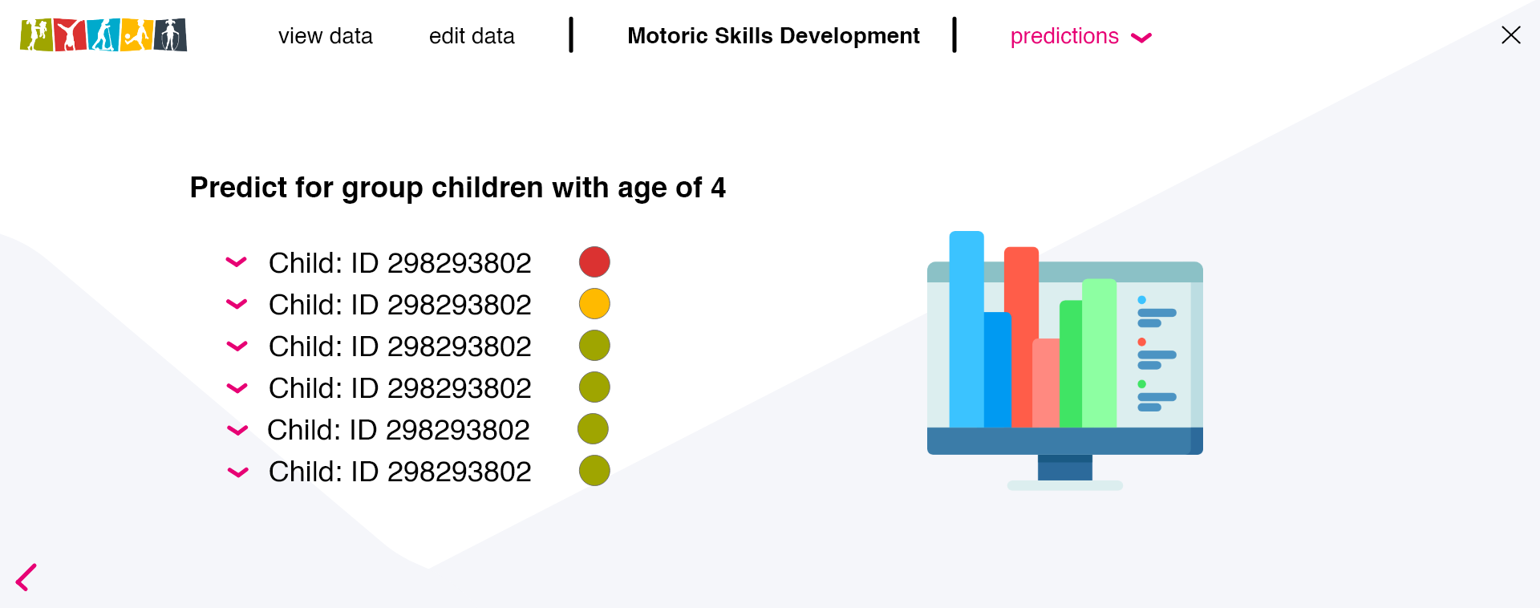
19
User Interface Prototype

Slide 20
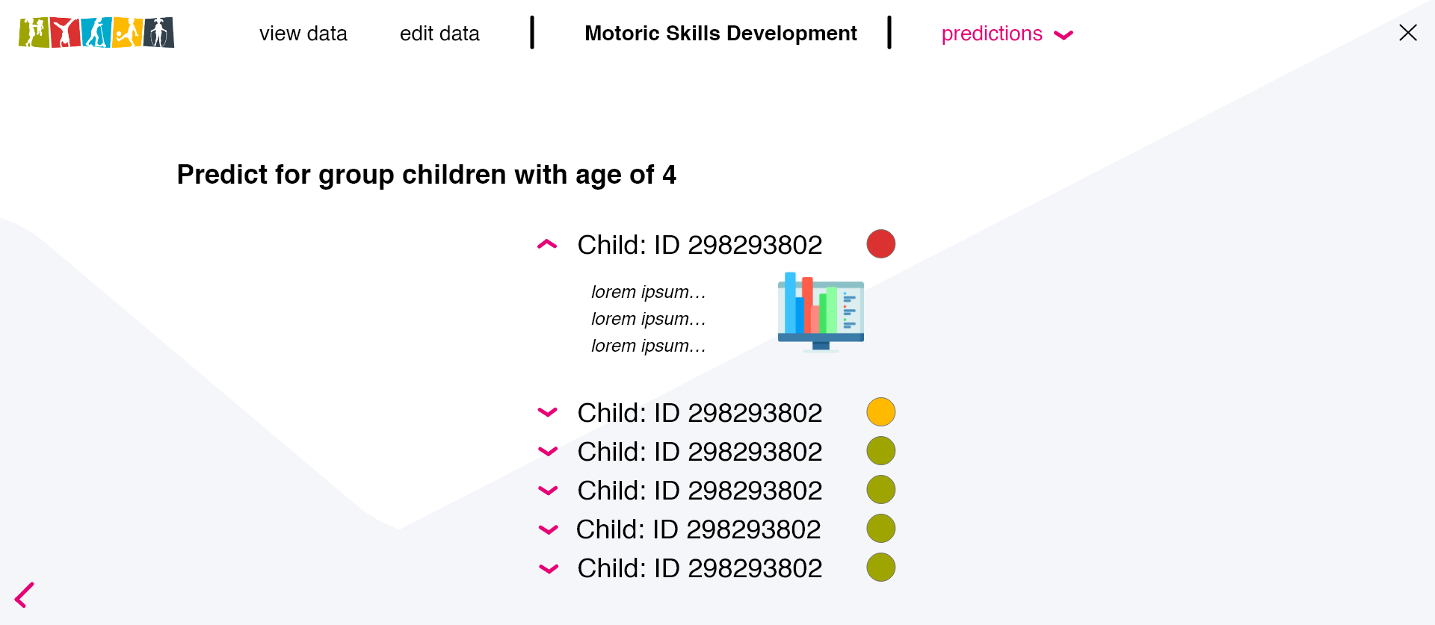
6
User Interface Prototype

Slide 21
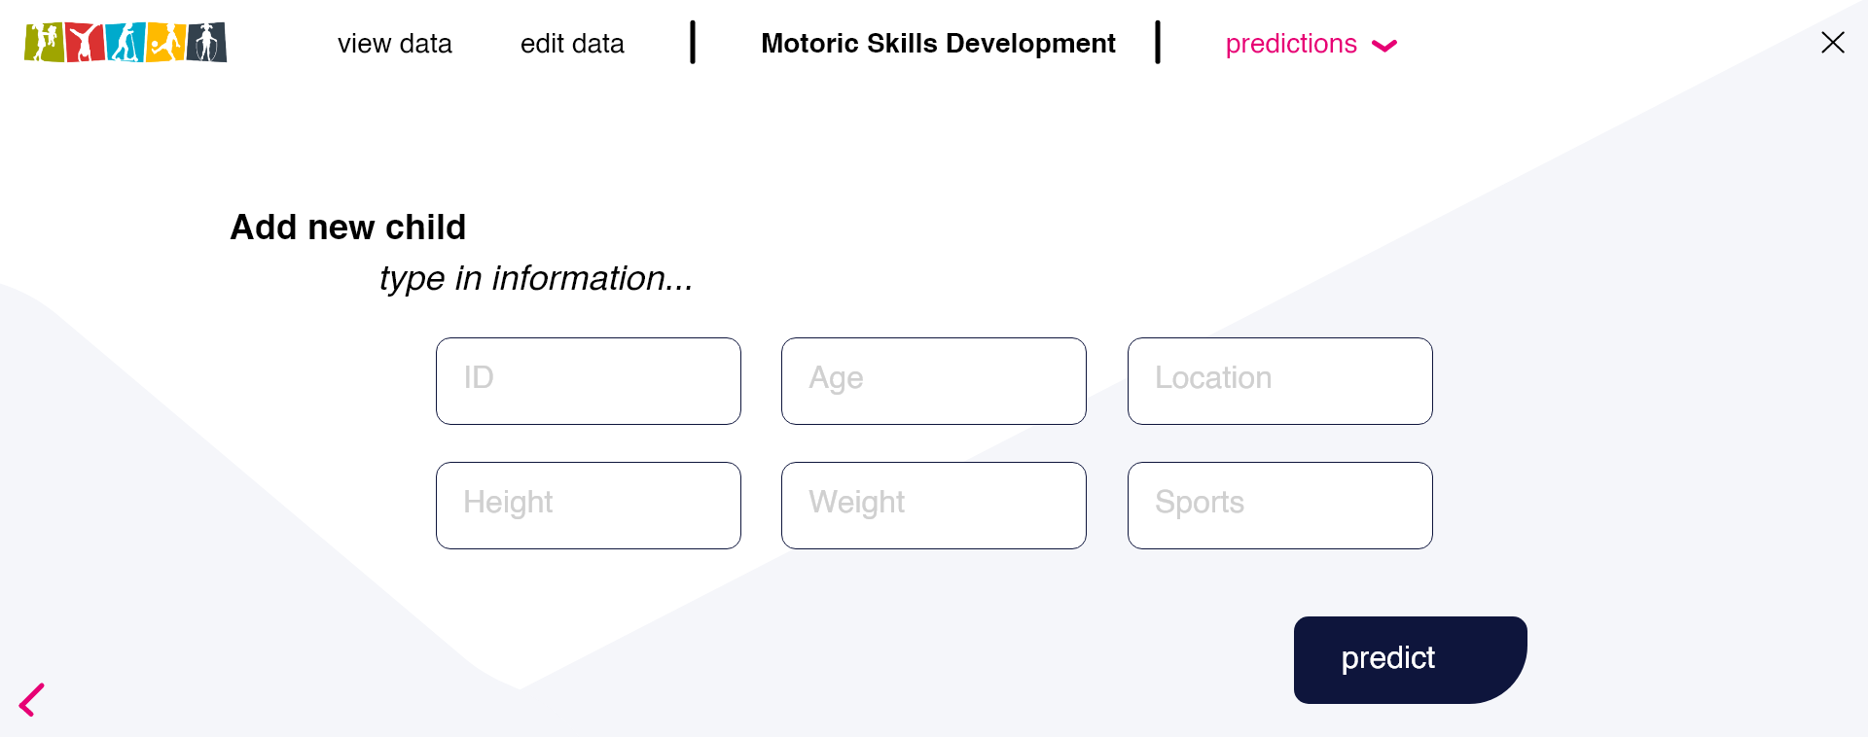
6
User Interface Prototype

Slide 22
6
User Interface Prototype

Slide 23
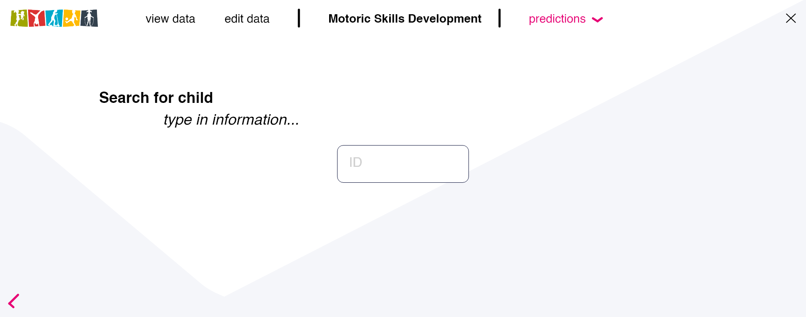
6
User Interface Prototype

Slide 24
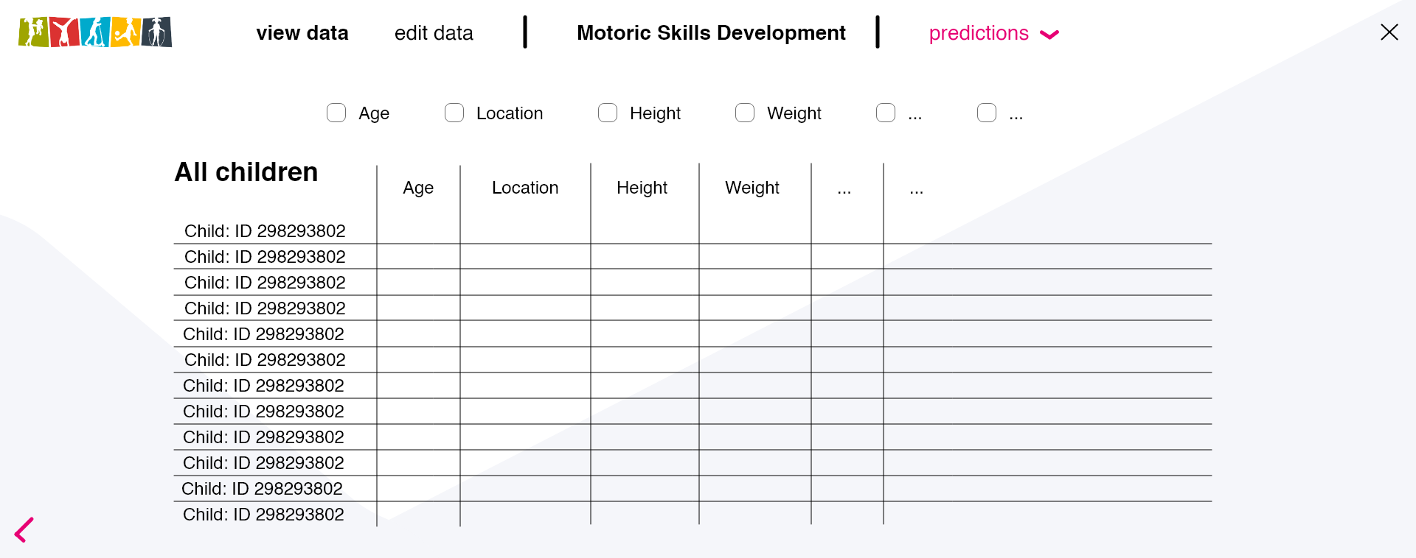
6
User Interface Prototype

Slide 25
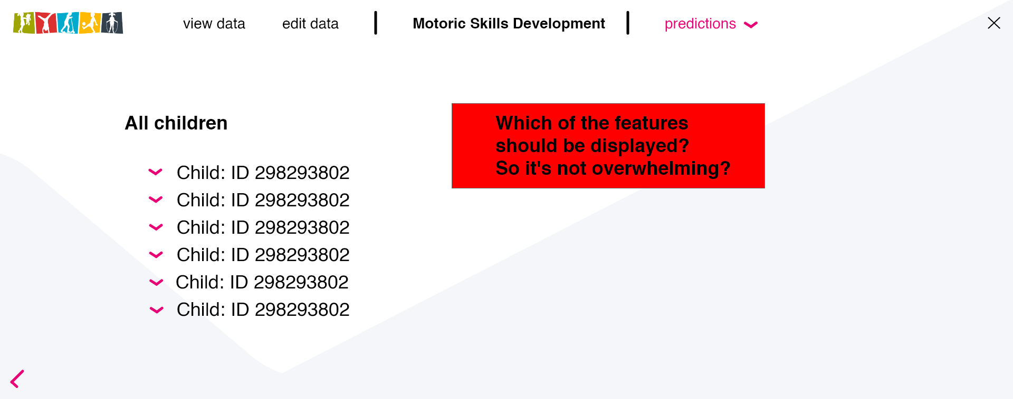
6
User Interface Prototype

Slide 26
thank you
Questions

